Slide 1

A Non-Invasive Approach for Diagnosing Endometriosis Using Deep Learning
Supervisor: Miri Weiss Cohen
Daniel Berkowitz
Tal Turjeman

Slide 2
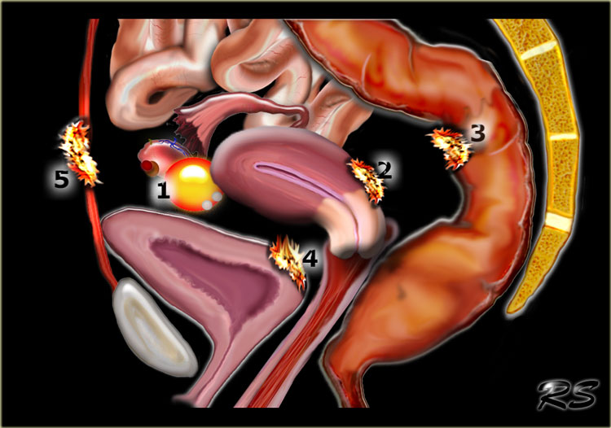

Endometriosis
What is Endometriosis ?
Endometriosis is an inflammatory, chronic gynecologic disorder that affects about 10% of women worldwide.
Endometriosis is characterized by the growth of endometrial-like tissues outside the uterine cavity.
These growths, called endometriotic lesions, can develop on different pelvic organs.
Unlike normal endometrial tissue, these lesions do not shed during menstruation, leading to inflammation, pain, and scarring.

Slide 3

Common Symptoms of Endometriosis
Severe pelvic pain, especially during menstruation.
Pain during intercourse.
Chronic lower abdominal pain.
Infertility due to tissue scarring.
Bowel and urinary symptoms.
Fatigue and mental health challenges.

Slide 4
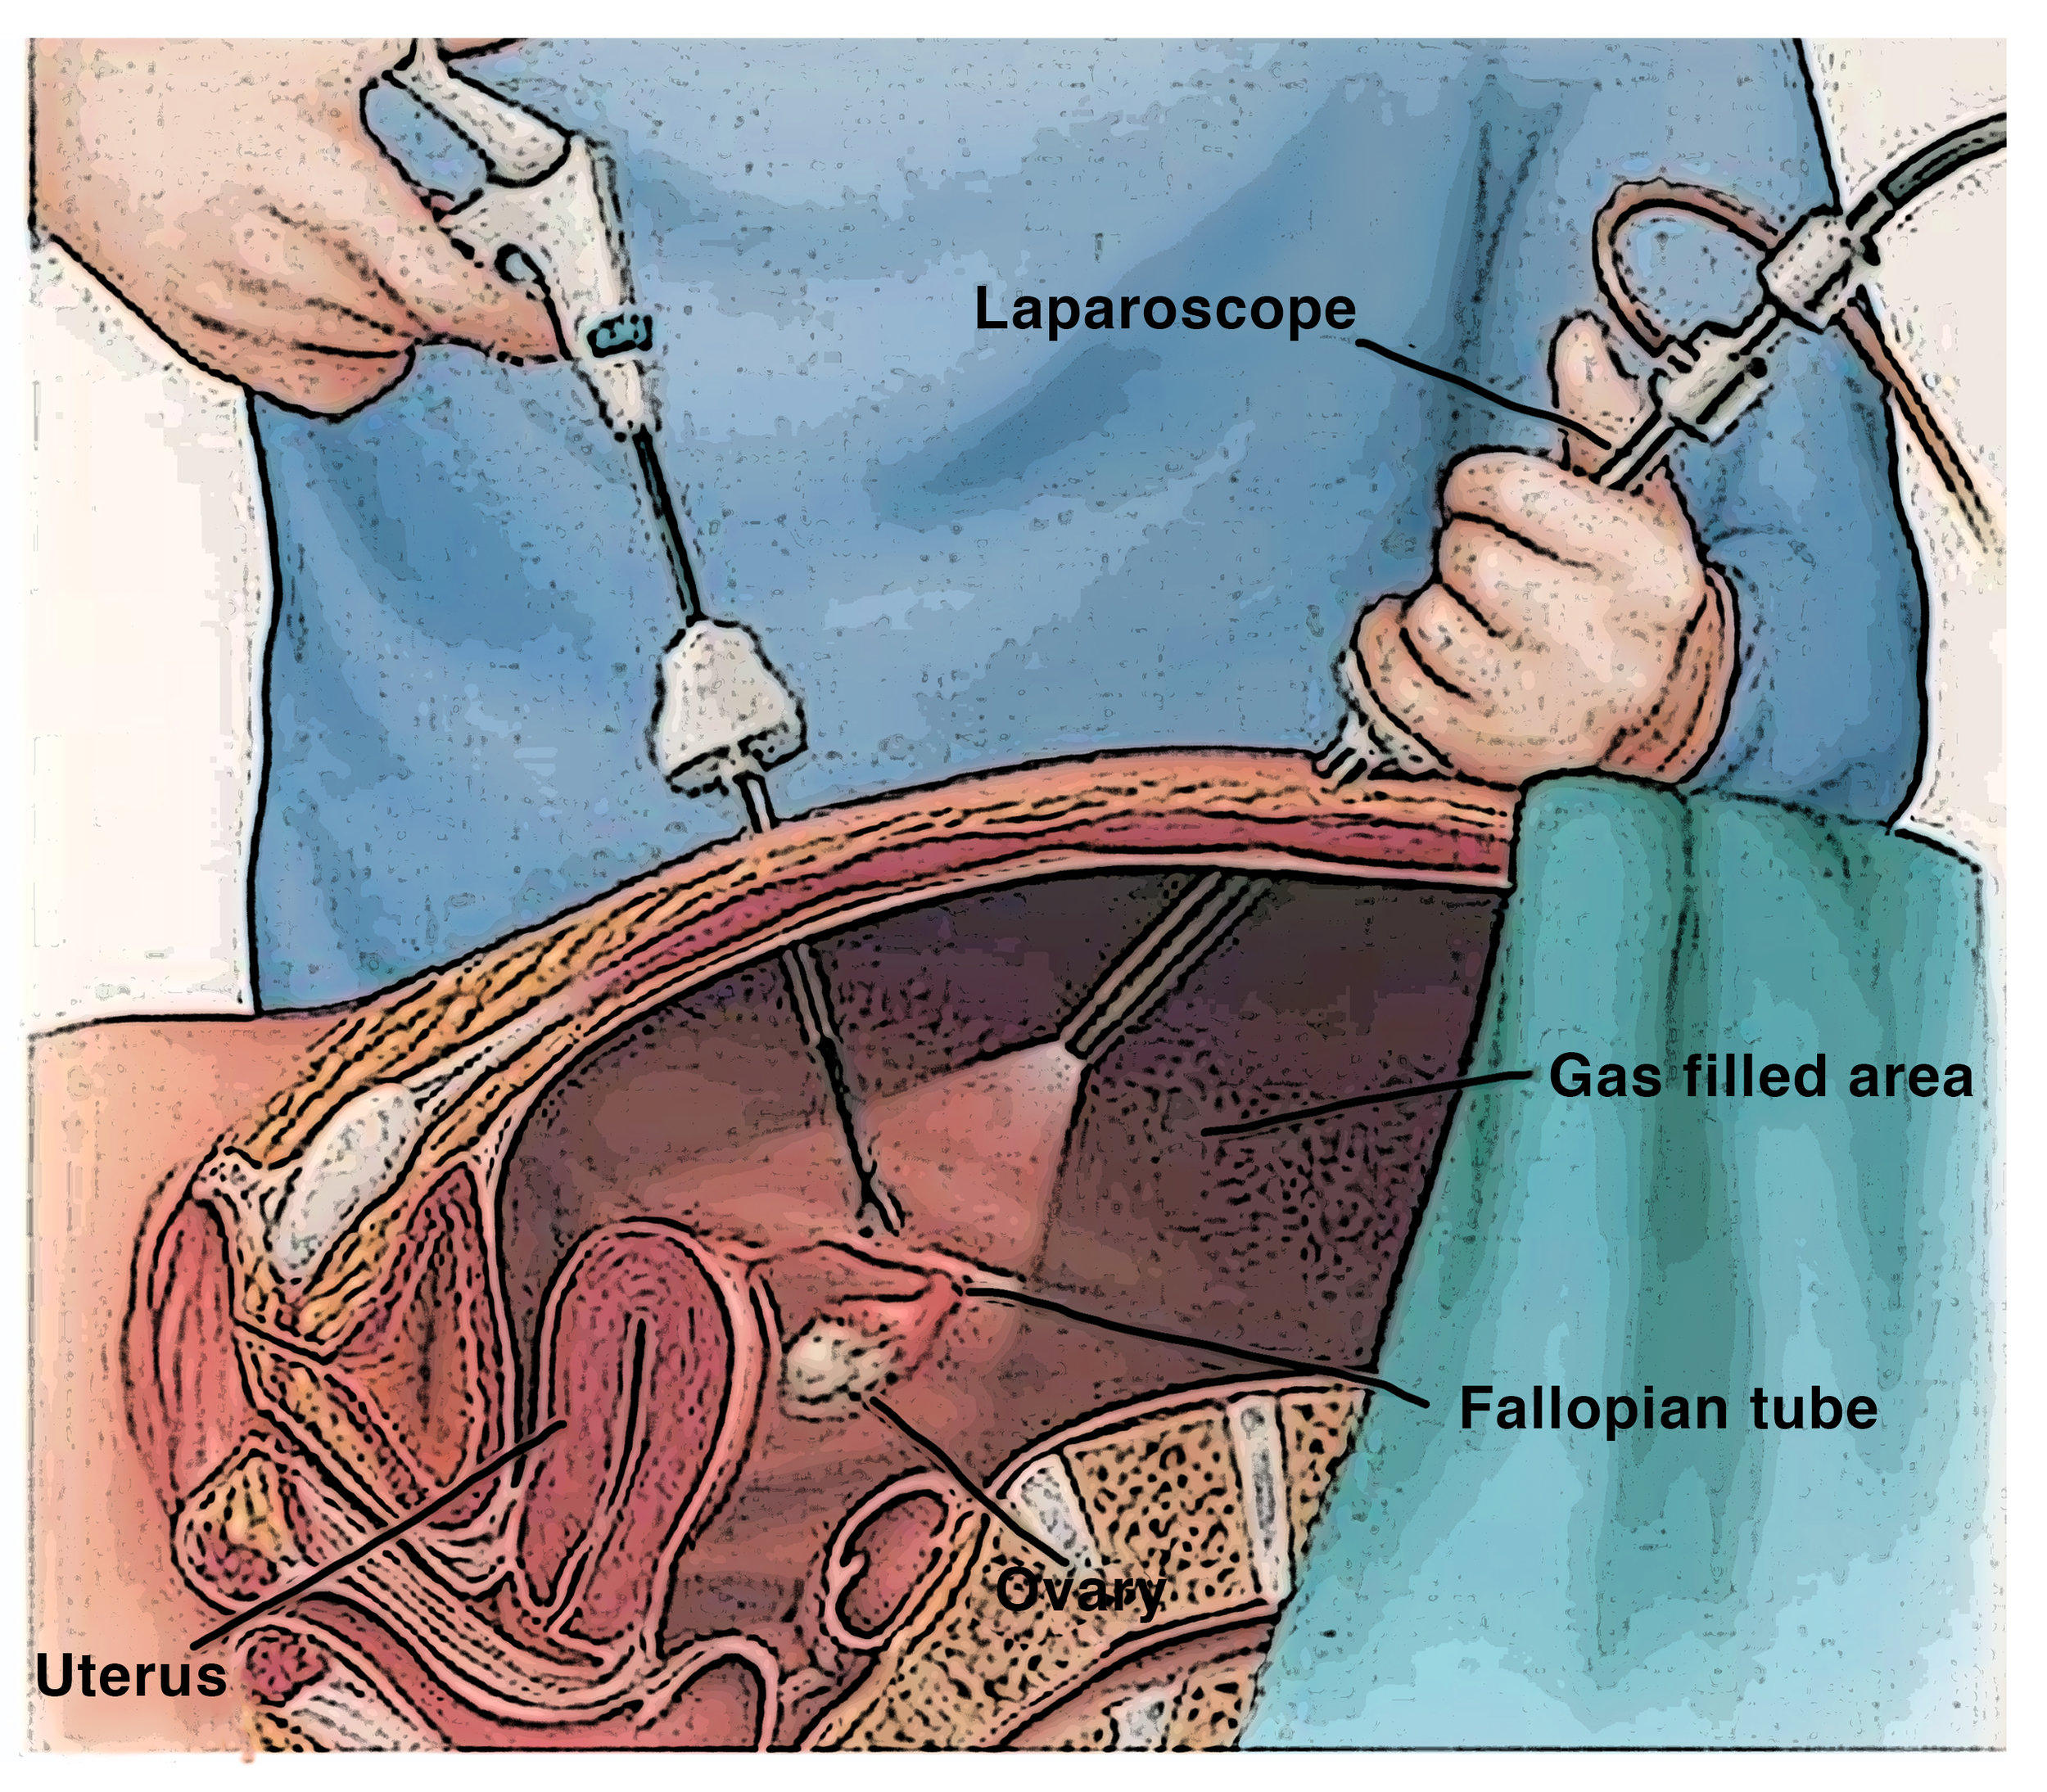
The current situation and need for the project
Endometriosis is often misdiagnosed disease
Many women suffer for years without diagnosis, which significantly affects their quality of life.
The problem with current diagnostic methods
The gold standard for diagnosis is laparoscopy, an invasive and expensive procedure.
Laparoscopy involves inserting a camera into the abdomen to visually confirm the presence of endometrial-like tissue.
The average diagnostic delay is between 8 to 12 years.

Slide 5
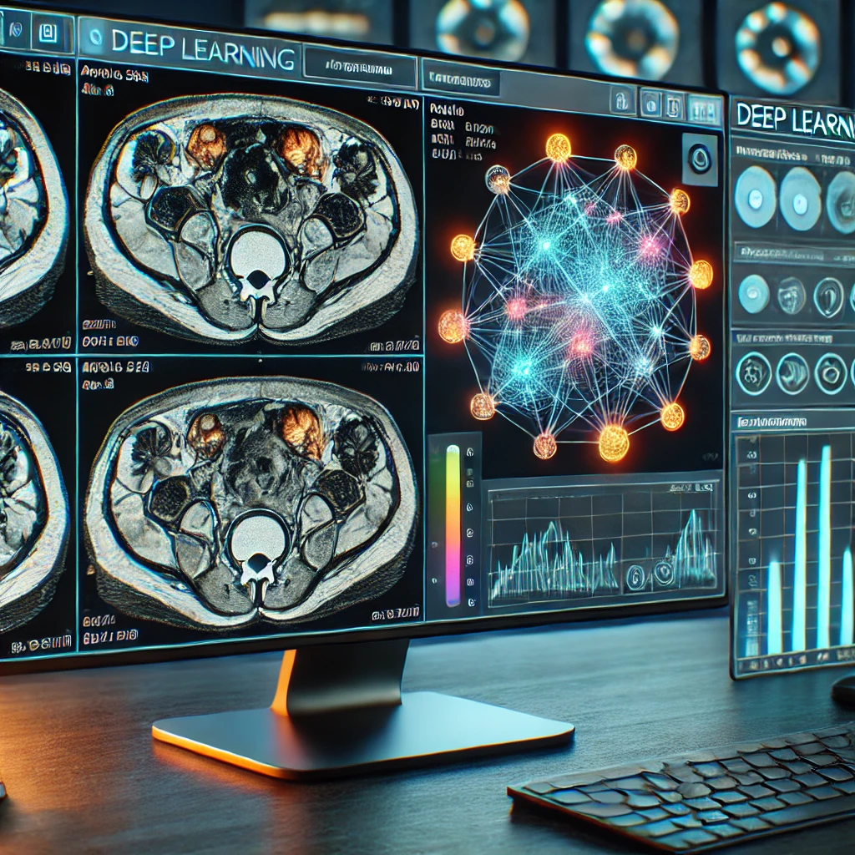
The current situation and need for the project
Why machine learning can help
MRI scans can show endometriotic lesions, but their identification by radiologists is challenging due to variations in size, shape, and location.
No existing machine learning model is designed for MRI based endometriosis detection.
Deep learning improves medical imaging by detecting patterns missed by the human eye, enabling faster and more accurate diagnoses.

Slide 6
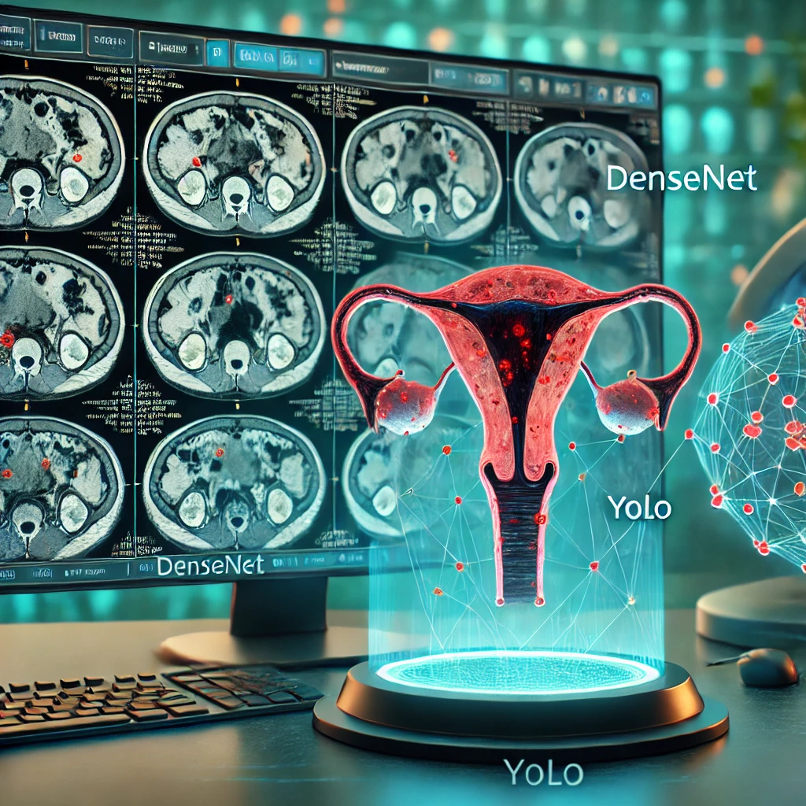
The solution
Deep learning model that analyzes MRI scans to automatically detect endometriosis using DenseNet and YOLO to classify and mark lesions.

Slide 7
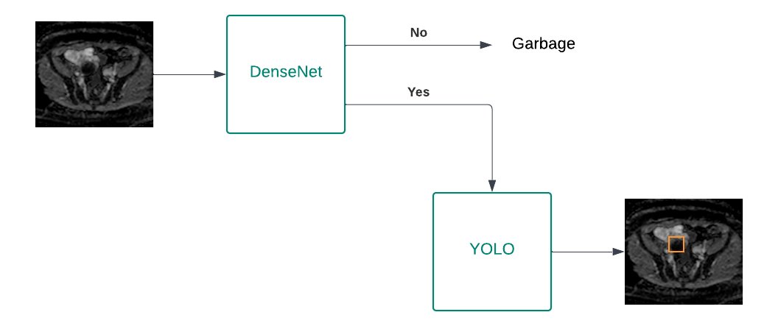
System architecture
The system receives an MRI scan as input.
DenseNet classification:
If the scan does not have evidence of endometriosis, it is discarded as garbage.
If the scan has evidence of endometriosis, it is passed to YOLO.
YOLO detection:
YOLO analyzes the classified scan to detect and mark endometriotic lesions.
The output is the final segmented scan with boundary box for each lesion.

Slide 8
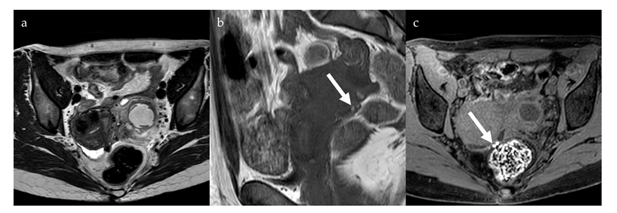
Scientific and technological background
MRI and Endometriosis Diagnosis
MRI is a non-invasive imaging technique that generates detailed images of internal structures.
It is widely used in medical diagnostics, especially for soft tissue evaluation.
Endometriotic lesions can be visualized in MRI scans, making it a valuable tool for diagnosis.

Slide 9
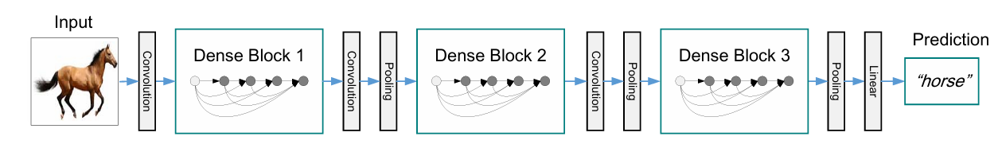
Algorithms and implementation
What is DenseNet ?
Deep learning architecture that improves feature propagation and reuse by creating direct connections between each layer and every other subsequent layer.
This minimizes the vanishing gradient problem, lowers computational costs, and enhances model performance with fewer parameters.
It is widely used in image classification tasks, particularly in medical imaging, where extracting patterns from complex scans is essential.

Slide 10
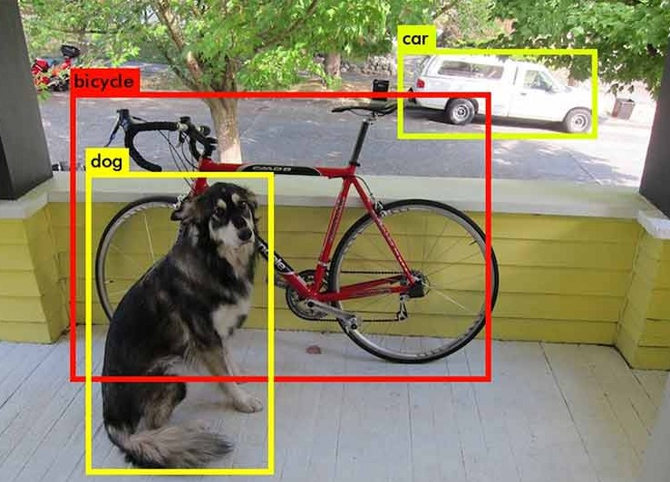
Algorithms and implementation
What is YOLO ?
Advanced object detection algorithm that processes an entire image in a single pass, making it one of the fastest and most efficient models for real-time detection tasks.
This approach allows for both speed and accuracy, making it useful in scenarios where fast identification of objects is critical.
Continuously improving with better accuracy, fewer false positives, and enhanced small object recognition.

Slide 11
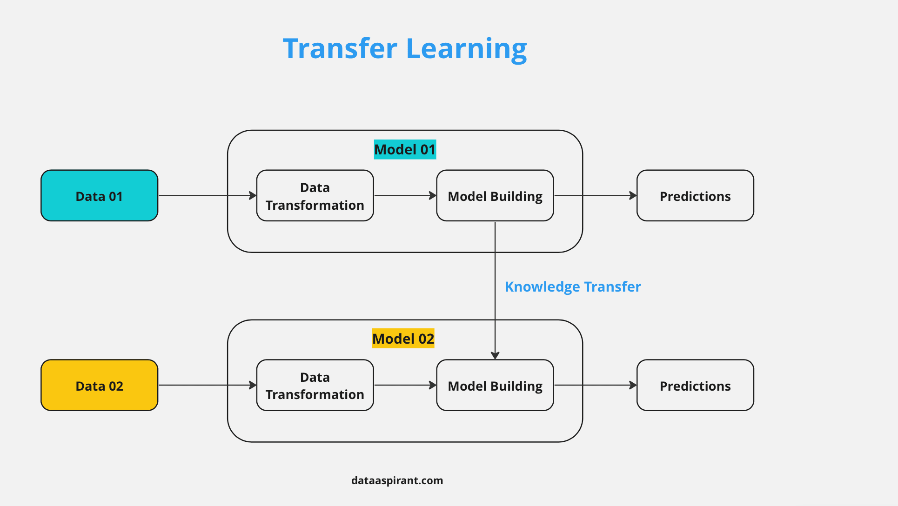
Algorithms and implementation
What is transfer learning ?
This is a machine learning technique that uses pre-trained models to improve performance on new tasks.
Instead of training a model from scratch, it allows models to apply knowledge to new datasets.
It is especially useful in fields with limited labeled data, such as medical imaging.

Slide 12

System optimization
The hyper parameters optimization
Learning rate – {5⋅e^(-3), 5⋅e^(-4), 5⋅e^(-5) }
Batch size – {16, 32, 64}
Epochs – {50, 100, 150}
Dropout – {0.2, 0.5}
Batch normalization – with / without

Slide 13

The results we aim for
Identification of Lesions with Over 80% Accuracy
The model must accurately detect and differentiate endometriotic lesions.
A non-invasive diagnostic tool
The system aims to assist or replace laparoscopy for diagnosing endometriosis, making diagnosis faster and more accessible.

Slide 14
Expected challenges
Lesion variability
Endometriotic lesions differ in size, shape, and location, making detection complex.
Differentiating endometriotic lesions from other abnormalities
The model needs to distinguish between endometriosis and other gynecological conditions, such as benign ovarian cysts, to minimize false detections and improve diagnostic reliability.
Limited labeled MRI data
The lack of marked medical datasets challenges model training, requiring data augmentation and collaborations with medical institutions.

Slide 15
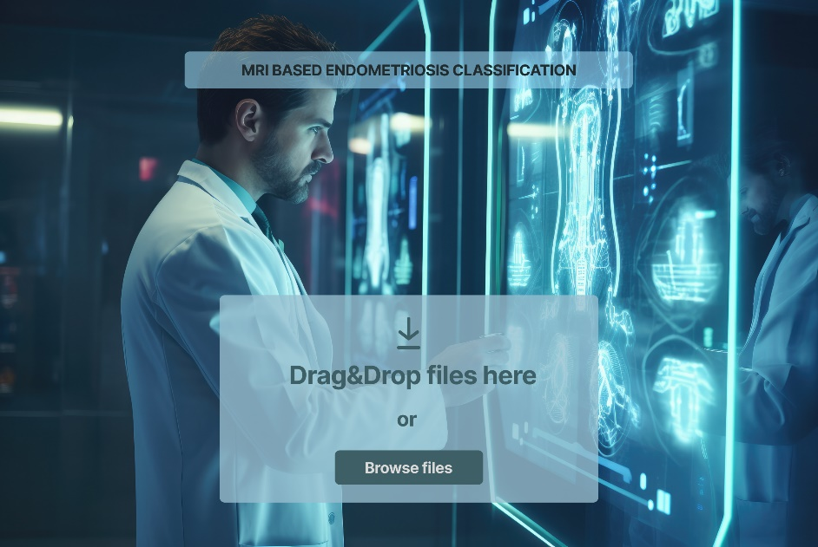
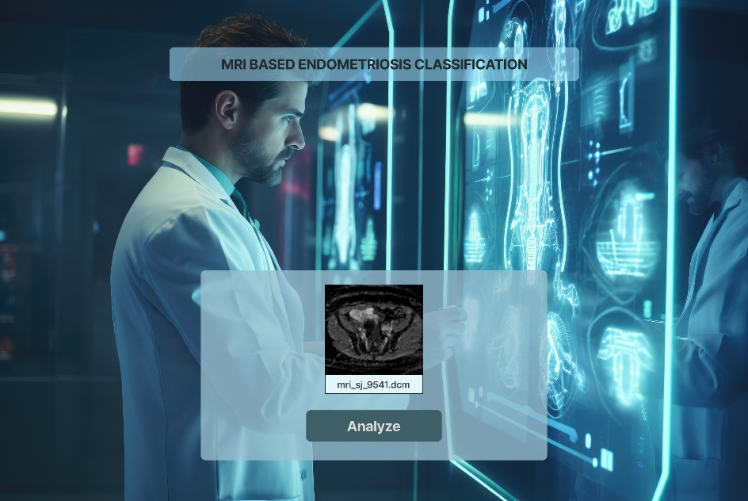
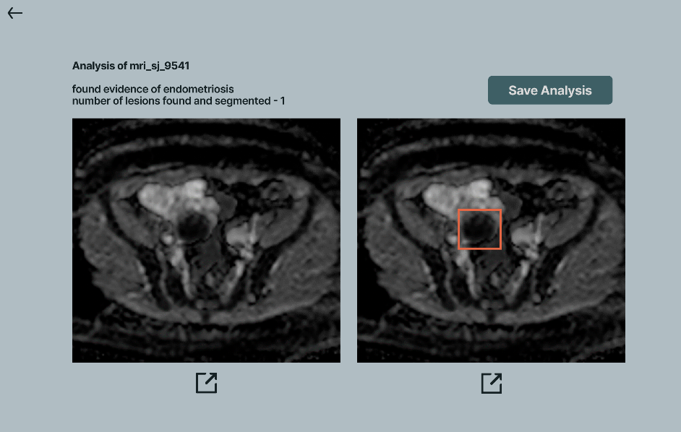
System interface

Slide 16
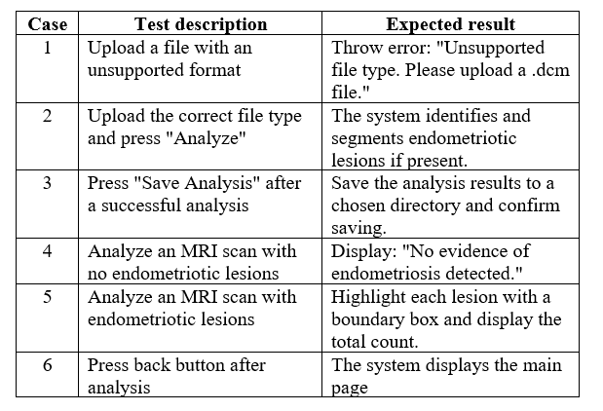
Tests for the system

